Slide 1
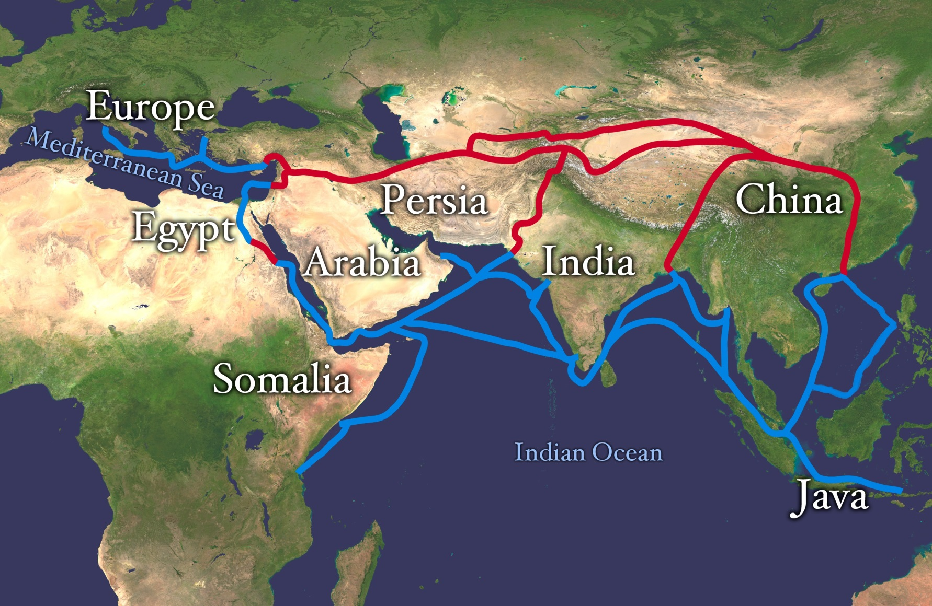
Hellenism, Commerce and Religion

Slide 2
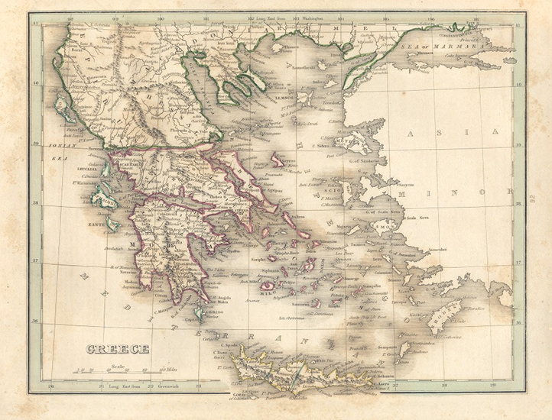
Macedonia
A kingdom north of Greece
Emerged as a state by the early 7th century B.C.E.
United as a kingdom under King Amyntas III around 392 B.C.E.
Became involved in the affairs of Greece
Adapted many aspects of Greek culture and society

Slide 3
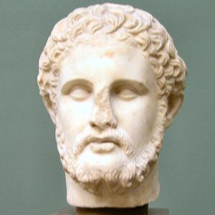
Phillip II of Macedon
Born the 3rd son to the royal family of Macedon in 382 B.C.E.
At the age of 14 offered as a hostage to the city of Thebes
Received his military and diplomatic education while a hostage
Held hostage until 365 B.C.E.

Slide 4
Phillip II
Returned to Macedon in 364 B.C.E.
Became King of Macedon in 359 B.C.E.
Developed ideas of expansion and conquest
Introduced the idea of the phalanx infantry unit
Defeated an Athenian army in 359 B.C.E.
Consolidated his power in Macedon and northern Greece by 355 B.C.E.

Slide 5
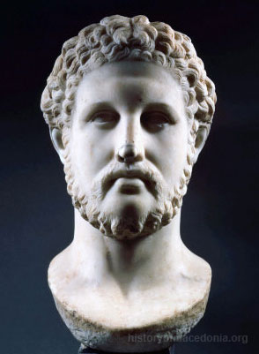
Phillip II
In 356 B.C.E. 3 great things happened to Phillip: conquest of Crenides, birth of Alexander and his horse won the Olympic Games
Conquered much of Greece by 337 B.C.E.
Developed plans for an invasion of Persia
Assassinated in October 336 B.C.E. at his daughters wedding

Slide 6
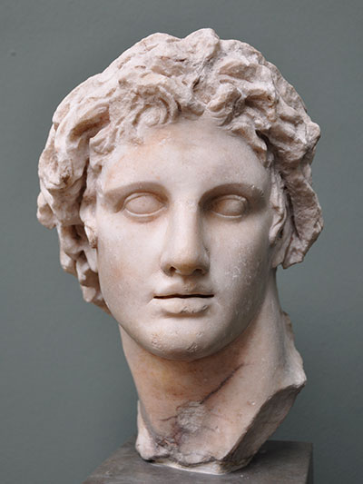
Alexander the Great
Born in Pella in July 356 B.C.E.
A student of Aristotle from 343 - 340 B.C.E.
Acted as regent while Phillip II was away at war
In 337 B.C.E. Phillip II’s marriage and new born son threatened Alexander’s position

Slide 7
Alexander the Great
Became ruler of Macedon in 336 B.C.E. after the assassination of his father
Phillip’s death led to open revolts in Greece
Began an campaign to eliminate possible rivals to the throne
Consolidated his power in 335 B.C.E.
In 335 B.C.E. began preparations to fulfill his father’s dream of invading the Persian Empire

Slide 8
Invasion of the Persian Empire
Macedonian army consisted of about 48,000 infantry, 6,000 cavalry and 120 ships
Alexander launched the invasion in early 334 B.C.E. when he crossed the Hellespont
Darius III initially failed to react to the movement of the Macedonian army
In April 334 B.C.E. Darius III dispatched an army to confront the Macedonian army

Slide 9
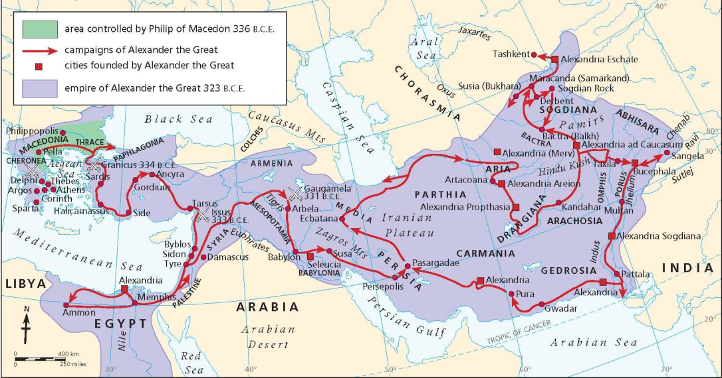
Invasion of the Persian Empire
Persians were defeated at the Battle of Granicus in May 334 B.C.E.
Alexander laid siege to the city of Halicarnassus in 334 B.C.E.
Persians were defeated at the Battle of Issus in November 333 B.C.E.
Alexander laid siege to the city of Tyre in 332 B.C.E.

Slide 10
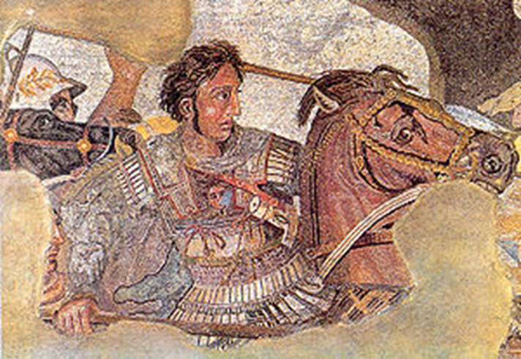
Invasion of the Persian Empire
Alexander invaded Egypt in 332 B.C.E. and was seen as a liberator
Persians defeated at the Battle of Gaugamela in October 331 B.C.E.
Babylon and Susa fall in 330 B.C.E.
Alexander defeated the last Persian army in the winter of 330 B.C.E

Slide 11
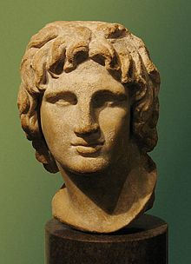
Alexander the Great
Conquered areas along the Indus River valley in 327 and 326 B.C.E.
Alexander’s soldiers refused to go any further
Created an empire that stretched from Greece in the west to India in the east
Died of fever in Babylon in 323 B.C.E.

Slide 12
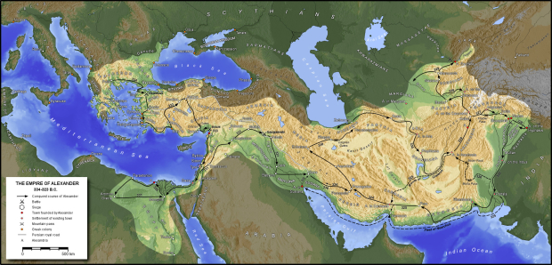
Empire of Alexander the Great

Slide 13
Aftermath of Alexander’s Death
Alexander left no clear heir to his empire
His generals sought to keep the empire united
Disagreements among his generals led to years of internal fighting and civil wars
His generals began to establish independent territorial states and alliances
The issue was finally decided after the Battle of Ipsus in 301 B.C.E.

Slide 14
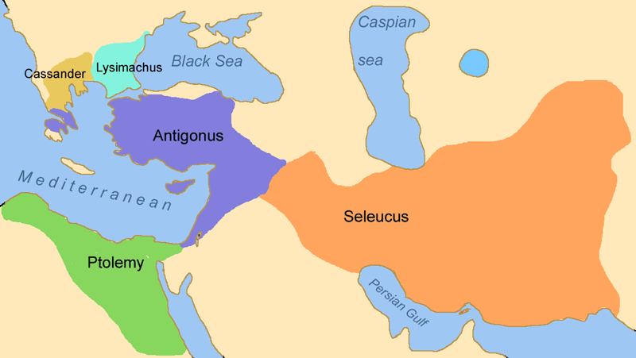
Division of Alexander’s Empire
Cassander became King of Macedonia
Lysimachus took control of Thrace
Ptolemy I founded the
Ptolemaic Dynasty in Egypt
Seleucus I founded the Seleucid Dynasty in Mesopotamia
Antigonus I founded the Antigonid Dynasty in Asia Minor

Slide 15
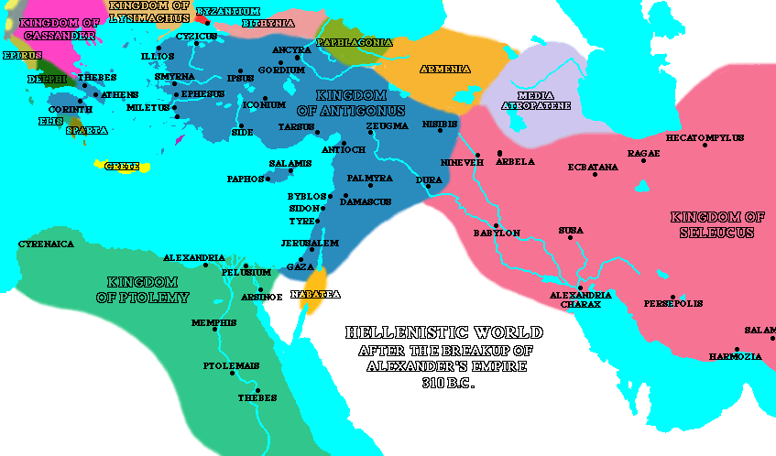
The Hellenistic World
The successor states helped to spread Hellenistic culture
Introduced new ideas on philosophy and politics
Linked large areas with a “common Greek ” language
Expanded trade across lands of the former empire

Slide 16
Schools of Greek Philosophy
Epicureans – founded in 307 B.C.E. by Epicurus of Athens; believed happiness in life could be achieve through knowledge of the workings of the world, limiting ones desires and reason
Stoics – founded in the 3rd century by Zeno of Citium; believed humans must live in harmony with nature and themselves in order to achieve happiness

Slide 17
Leaders in Scientific Thought in Classical Greece
Euclid – considered the “father of geometry,” introduced the ideas of plane geometry, geometrical algebra, tangents and polygons
Archimedes – introduced the idea of the lever and hydrostatics
Heraclides – introduced the idea of the heliocentric universe
Aristarchus – introduced the idea that the sun and stars were stationary and the planets, including the earth, revolved around the sun with the earth revolving on an axis

Slide 18
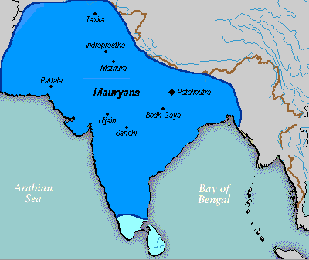
Mauryan Empire
Occupied areas vacated by the retreating army of Alexander the Great in 325 B.C.E.
Originated from the kingdom of Magadha south of the Ganges River
Established as an empire by Chandragupta Maurya around 322 B.C.E.
Largest empire ever on the Indian sub-continent

